Slide 1
Artificial Intelligence and Law - Theory and Application
Lecture 1

Slide 2
Course Introduction and Syllabus Review
Review Syllabus and Structure of Course
Note: the content of the lectures listed on the syllabus is subject to change.
Discuss goals for the course and expectations
Discussion: why it is important and useful for lawyers to have AI literacy?
Discussion: what is your experience with AI and general impressions of AI?

Slide 3
What is Artificial Intelligence (“AI”)?
Per the most widely used textbook on AI*, AI has five components:
Acting Humanly - Turing Test Approach
Thinking Humanly - The Cognitive Science Approach
Thinking Rationally - The “Laws of Thought” Approach
Acting Rationally - The “Rational Agent” Approach
Beneficial Machines
*Artificial Intelligence - A Modern Approach, Stuart Russell and Peter Norvig

Slide 4
Acting Humanly - Turing Test Approach
Turing Test: a computer passes the test if a human interrogator after posing some written questions to the machine cannot tell whether the responses come from a person or a computer.
What would a computer need to pass the test?
Natural language processing
Knowledge representation
Automated reasoning
Machine learning
Computer vision
Speech recognition
Robotics
The above seven disciplines compose most of the field of AI.
Similar thought experiment - Chinese Room thought experiment

Slide 5
Other Approaches to the “Definition” of AI
Thinking humanly - modeling AI after the human mind
Thinking and acting rationally - AI using logic and probability to achieve the best or best expected outcome for humans
Beneficial machines - ensuring that AI has value alignment with human values

Slide 6
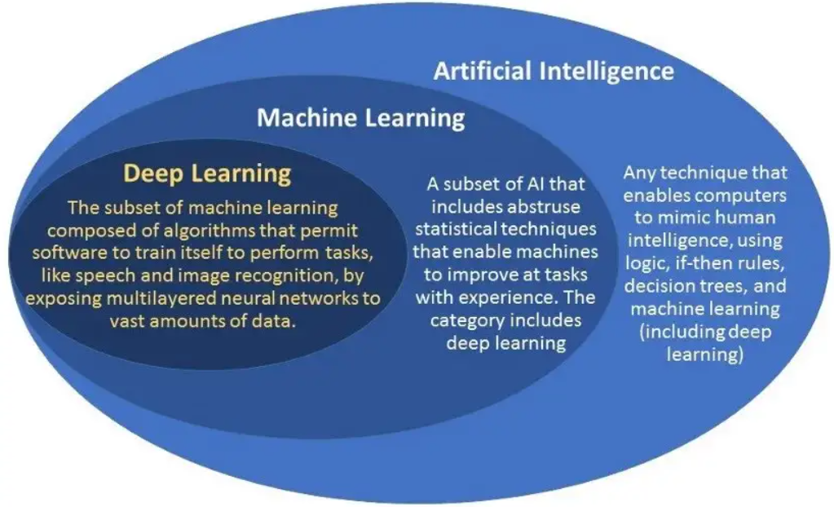
AI, ML, Deep Learning, Neural Networks, LLMs, and other Confusing Abbreviations
Source: https://www.unite.ai/machine-learning-vs-deep-learning-key-differences/

Slide 7

Machine Intelligence
Will it surpass human intelligence?
Source; https://chloeamberlouise.home.blog/2019/05/22/the-matrix-a-philosophy/

Slide 8
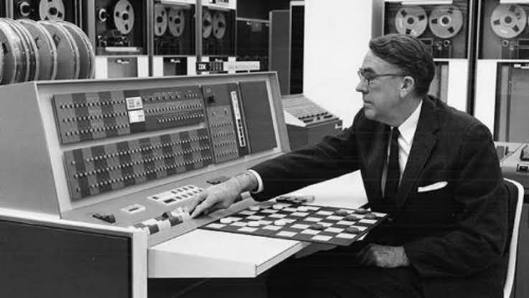
Intro To Machine Learning
“Field of study that gives computers the ability to learn without being explicitly programmed.” - Arthur Samuel (1959)
Categories of machine learning
Supervised learning
Unsupervised learning
Recommender systems
Reinforcement learning
Source: https://www.unocero.com/videojuegos/inteligencia-artificial-y-uno-de-sus-pioneros-a-l-samuel/

Slide 9
Supervised Learning
Algorithms that take input and produce output by learning from examples
Application | Input | Output
Language translation | English | French
Speech recognition | Audio | Text
Online advertising | User analytics | Click/Sale (Y,N/Y,N)
Self driving car | Video | Position of other objects
High frequency trading | Trend/parameters | Future value
Spam filter | Email text | Spam (Y/N)

Slide 10
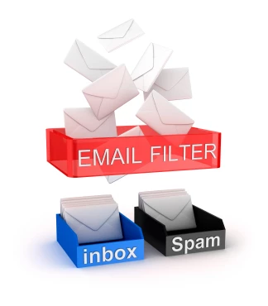
Spam Filter
How might we develop a spam filter?
Source: https://sendpulse.com/support/glossary/spam-filter

Slide 11
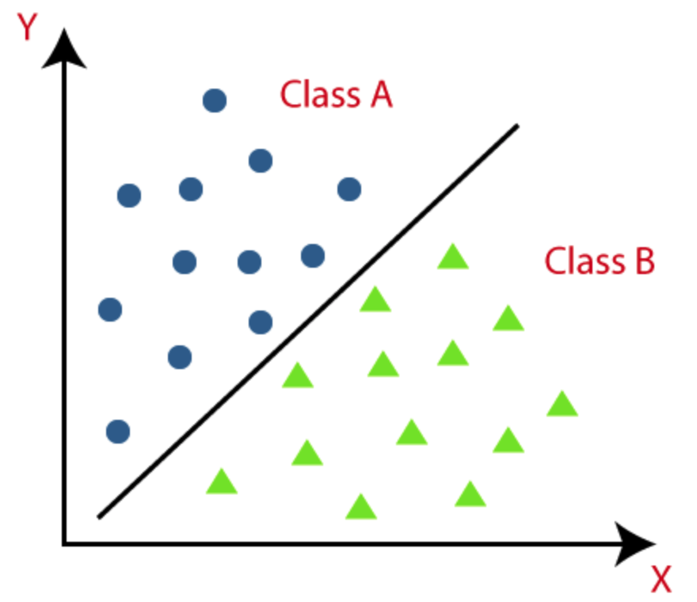
Supervised Learning Example 1 - Classification
Source: https://www.javatpoint.com/classification-algorithm-in-machine-learning

Slide 12

Predicting Housing Prices
How might we go about predicting the price of a house?
Source: https://www.sportskeeda.com/college-football/news-17-5-million-nick-saban-s-jupiter-island-home-might-retirement-abode-alabama-head-coach-paul-finebaum-rolls-theories

Slide 13
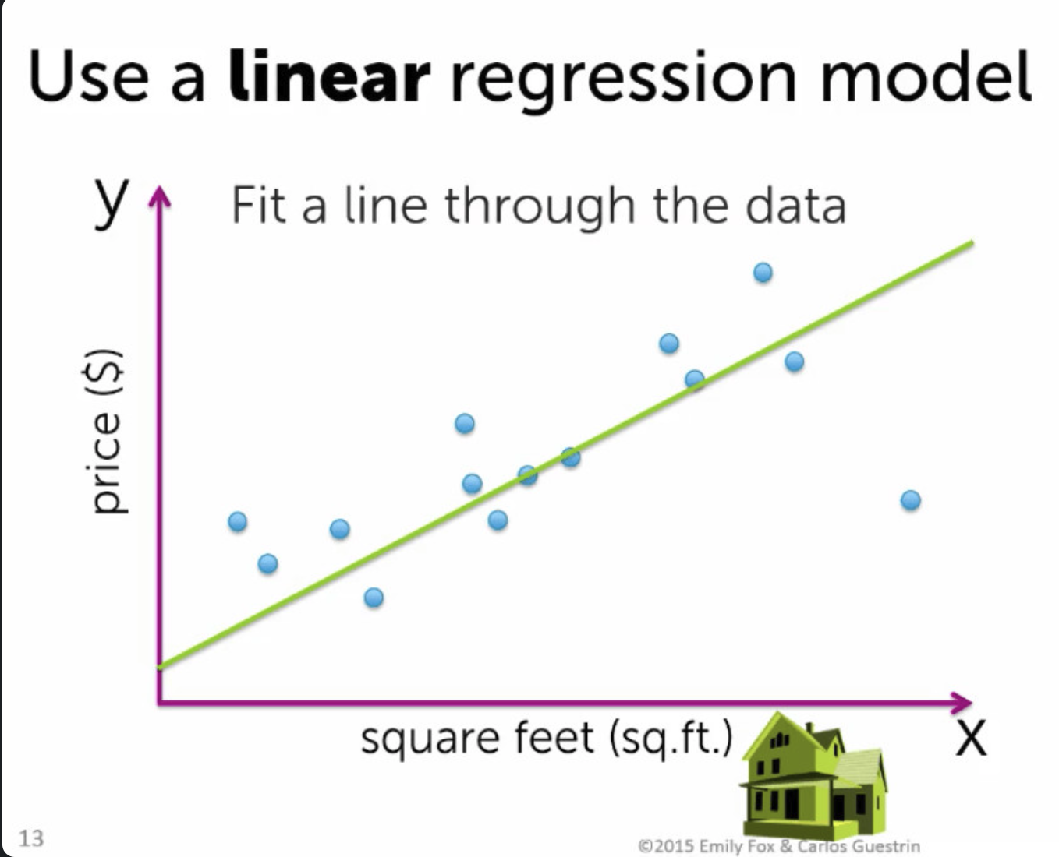
Supervised Learning Example 2 - Regression
Source: https://www.linkedin.com/pulse/predicting-house-prices-using-linear-regression-along-muhammet-ergenc/

Slide 14
Cats and Dogs Classification
How can you look at a picture of a cat or dog and visually identify whether it is a cat or a dog?
How might we use a computer to do this?

Slide 15


Supervised Learning Example 3 - Classification via Deep Learning
Input (x)
Neural Network
Output (y*)
Cost c(y,y*)

Slide 16
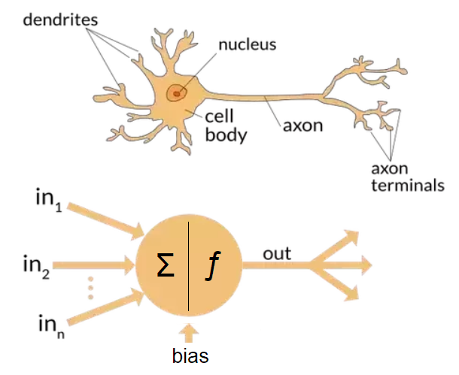
Neural Networks

Slide 17
Supervised Learning Example 4 - Recommender Systems
“They’re watching me” algorithms
Examples
Netflix movie recommendations
Online Ads
Instagram and TikTok “for you” pages
Huge commercial application
From a legal perspective, these algorithms have lots of privacy law issues
Recommender systems can be implemented with lots of known data (“features”) or by inferring features (e.g. collaborative filtering)

Slide 18
Unsupervised Learning
Unsupervised learning does not provide labeled training data; instead it provides unlabeled data and the algorithm tries to make sense of the data
Example - credit card fraud detection

Slide 19
Reinforcement Learning - High Level Intuition
Analogy: how do you teach children to behave?
In reinforcement learning, we can assign a positive numeric reward to the program for good behavior and a negative numeric value for bad behavior.
Key concepts: reward function and “states”
It is often a difficult concept to grasp, but when you apply it to examples of how we learn, it makes more sense. In other words, it may seem at first that it is implausible to teach a robot how to walk or a drone how to fly just by rewards or punishments, but with tons of feedback, it will learn.

Slide 20
Examples of Industry Application of RL
Gaming:
Board Games: Google DeepMind's AlphaGo used RL to defeat the world champion in the game of Go.
Video Games: RL agents are trained to play and sometimes outperform human players in games like Dota 2, StarCraft II, and many classic Atari games.
Robotics:
Robotic Control: Training robots to perform tasks such as picking up objects, folding clothes, or walking.
Autonomous Vehicles: RL can be used to develop policies for self-driving cars to navigate environments.
Finance:
Portfolio Management: Optimizing investment strategies.
Trading: Developing algorithmic trading strategies to maximize returns.
Healthcare:
Treatment Recommendations: Suggesting optimal treatment policies for patients.
Drug Discovery: Accelerating the process of drug development by optimizing molecular structures.
Energy:
Grid Management: Optimizing energy consumption in grids to ensure efficiency.
Battery Optimization: Managing battery usage in devices or electric cars to extend lifespan or operational time.

Slide 21
Examples of Industry Application of RL
E-commerce:
Recommendation Systems: RL can be used to optimize product recommendations to users based on their behaviors.
Education:
Personalized Learning: Designing curricula that adapt to individual student needs and paces.
Marketing:
Ad Placement: Optimizing where and when to place ads to maximize viewer engagement or conversion.
Manufacturing:
Process Optimization: Enhancing manufacturing processes to minimize costs or maximize outputs.
Agriculture:
Crop Management: Using RL to manage watering, planting, and harvesting schedules for optimal yield.
Aeronautics:
Drone Navigation: Training drones to navigate complex environments or deliver packages.
Telecommunications:
Network Optimization: Adjusting network parameters in real-time to ensure optimal data flow and reduce network congestion.
Natural Language Processing:
Dialogue Systems: Training chatbots and virtual assistants to better converse with users.

Slide 22
Jailbreaking ChatGPT
https://gandalf.lakera.ai/

Slide 23
Homework
See syllabus for two “watchings” to view before next week.

